Slide 1



Inventory Dashboard_MSIL3
View in Power BI
Last data refresh:
3/12/2021 1:36:52 AM Eastern Standard Time
Downloaded at:
3/12/2021 1:45:17 AM Eastern Standard Time

Slide 2
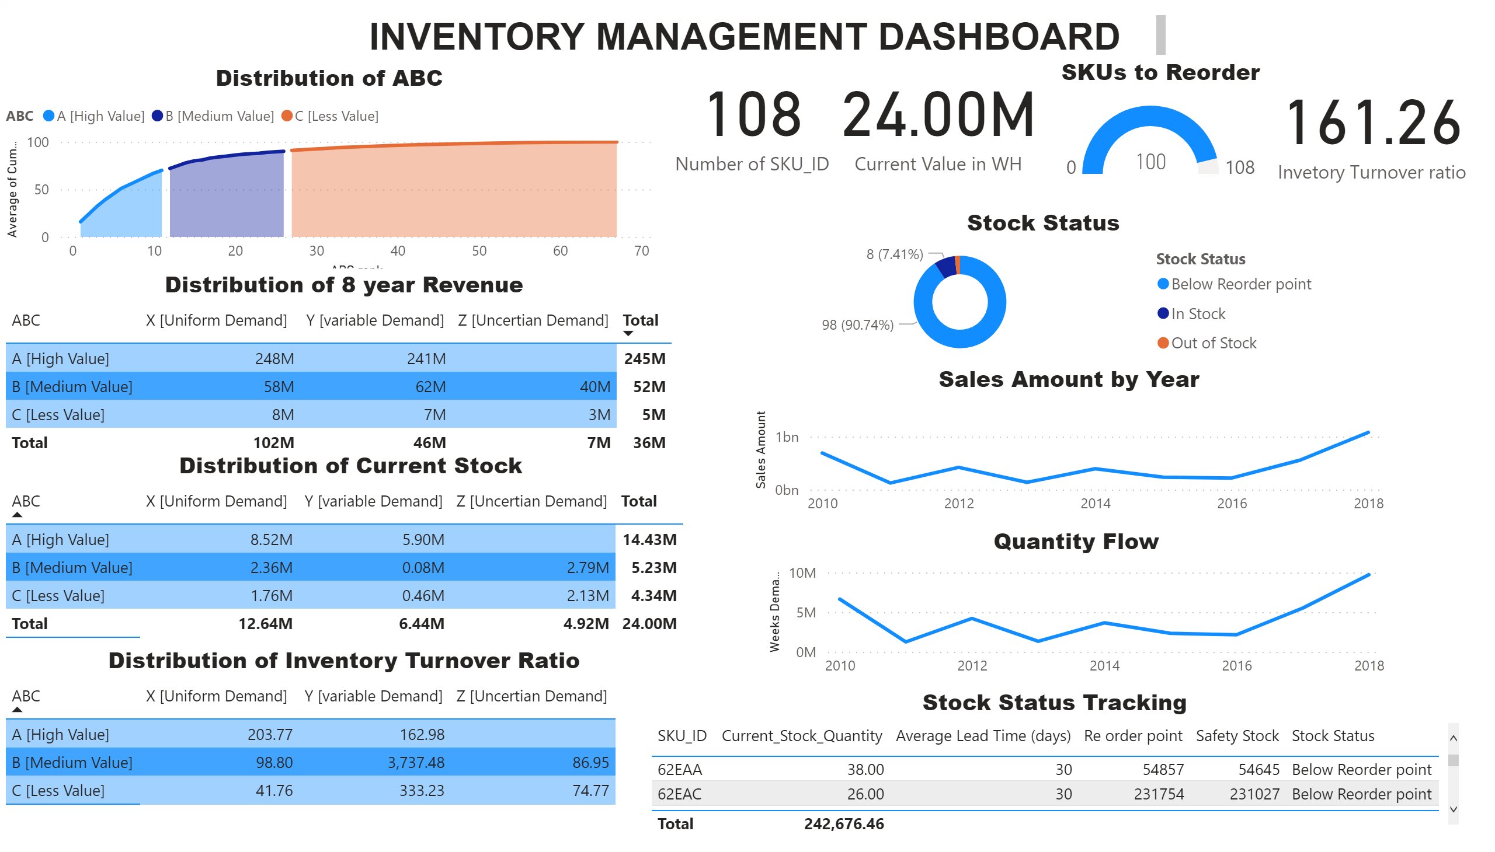
HOME
Notes:
Distribution of ABC
No alt text provided.
Distribution of 8 year Revenue
No alt text provided.
Distribution of Current Stock
No alt text provided.
Distribution of Inventory Turnover Ratio
No alt text provided.
Stock Status Tracking
No alt text provided.
card
No alt text provided.
card
No alt text provided.
SKUs to Reorder
No alt text provided.
card
No alt text provided.
Stock Status
No alt text provided.
lineChart
No alt text provided.
textbox
No alt text provided.
Quantity Flow
No alt text provided.

